Slide 1



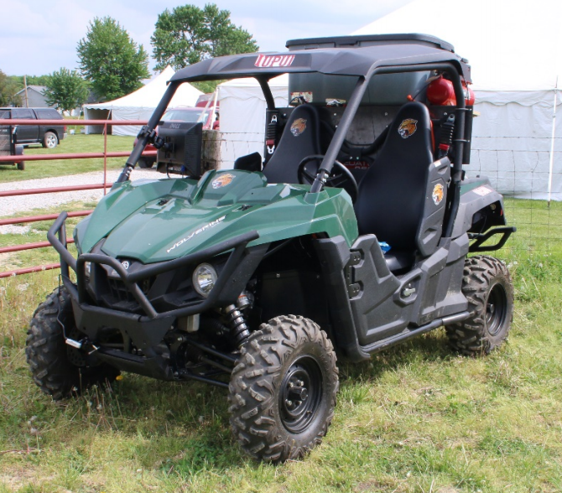
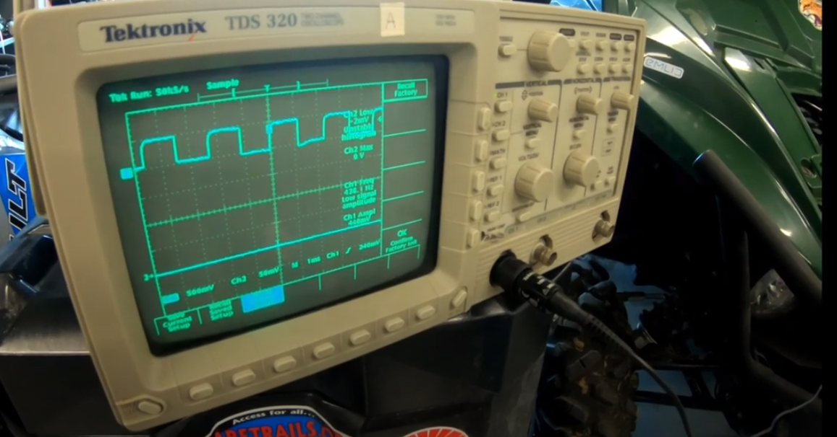
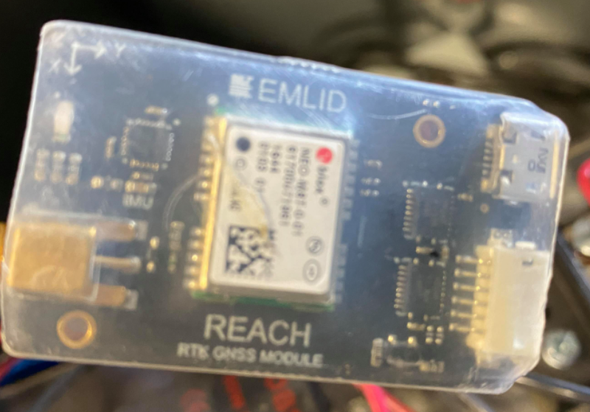
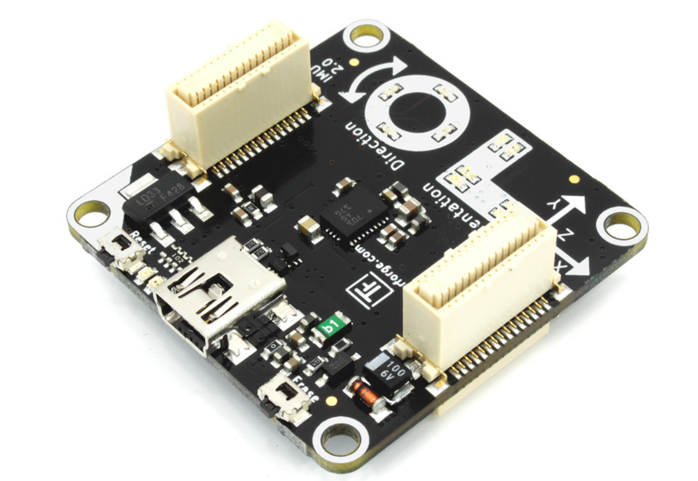
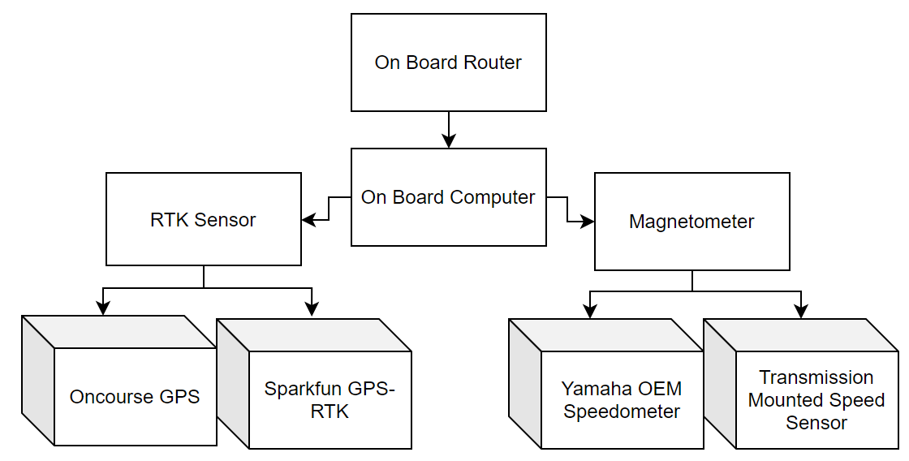
MEE Spring 2021 AgBot Group 1
John Baker, Trevor Baxter, Austin Van Haitsma,
Ryan Knight, and Parth Patel
Sponsor: Dr. Sohel Anwar
Motivation and Background
Conclusion and Results
Our group was tasked with optimizing certain subsystems on the Agricultural Robot or AgBot for short. Our group worked on upgrading the pre-existing autonomous navigation system’s accuracy and implementing a new way to capture speed data from the Yamaha Wolverine. These two systems will improve operating efficiency and lower operating costs for agricultural research and implementation.
We were successful at implementing the RTK module for more accurate location data. All previously claimed functionality was confirmed to be in working order. The local speed data was interpreted and verified from the onboard speed sensor which can eventually be implemented into the vehicle’s autonomous navigation subsystem in the future.
Project Requirements
Operate through a field with numerous 500-ft rows
Sensory data shall be transmitted back to base station in real time
Minimized Electromagnetic interference for RTK, GPS, and Wi-Fi while in operation
The AgBot must stop when a kill switch is used
Only weeds should be sprayed with chemicals
Operations must stop if obstacles are detected
GPS signal is used if RTK signal is lost
System Block Diagram
Future Work
Switch to Raspberry PI or Jetson TX2
Install Ubuntu 20.04 or the latest version
Install ROS Melodic/Noetic or the latest version
Upgrade onboard PC depending on future budget
Possibly upgrade to brand new system
Incorporate interpreted speed data into AGBot’s autonomous navigation system
Notes:
The picture of the Emlid Reach RS+

